Slide 1



Team: Raid Area 51
Rakesh Choudhury
Quan Peng
Rohan Yewale
MEDICARE
………make life easier

Slide 2

OBJECTIVE
Improving the condition of people with rare diseases by providing them to health camps, delivering medicine along with financial aid at the right time with our software solution.
Since they are very rare around the world this software empowers them for the easy access to their medical solution and efficient medicine accessibility.
This Photo by Unknown Author is licensed under CC BY-NC-ND

Slide 3

PROBLEM STATEMENT
It's very difficult for a person with a rare disease to seek help in a hospital.
Most of the health camps usually set up their camps for the usual diseases.
Enormous drug price in country like USA.
No easy access to medicine for people with rare disease.
Huge travel expense for getting a check up done from a specialist who is in another state or country.

Slide 4
SOLUTION TO THE PROBLEM
Doctor: It is very difficult for the patient with rare disease to access to Doctor who has specialization with that particular disease. This application help them get consultation from doctor online without visiting the hospital which would be far away from their place.
Finance: The drug is very expensive in country like USA. So this application help those people with low annual income get financial support from bank run by government to get medicines at a lower price.
Medicine Supply: Sometimes the medicine recommended by the doctor for their disease are not available in very few pharmacy store. So this application helps them to order medicine online.
Health Camps: Most of the health camps are for treating very common diseases. However, this application updates the health camps about the patients with rare disease so that the health camps make the those particular medicines and checkups available for those patients.

Slide 5
APPROACH
There are 6 enterprises which runs it’s own organizations and those are Patient, Health Camps, Delivery Logistics, Medicine Supplier, Financial Aid, Hospital.
The patient organization raise the request for all the other Enterprise and the patients request status gets updated as it is processed by different organizations in different enterprises.
For instance, the patient wants to get a financial from a government Bank so he/she can raise a request along with his/her financial document. The bank employee from one of bank organizations will try to process it whichever bank feels like the criteria is satisfied.

Slide 6
USE CASES
System Manager
• View/Add/Update/Remove Network.
• View/Add/Update/Remove Patient.
• View/Add/Update/Remove Hospital.
• View/Add/Update/Remove HealthCamps.
• View/Add/Update/Remove Funding.
• View/Add/Update/Remove Medicine-Supplier.
• View/Add/Update/Remove Delivery.

Slide 7
USE CASES
Patient
• Request Health Camp Services
Browse Through medicine and get the cost.
View Camp Confirmation Status.
• Request for Medicine Delivery
Place order for Medicine.
View Cost of Transportation.
View Cost of Medicine.
View Order status
contd…...

Slide 8
• Request Medical Treatment
Fill out all the details along with symptoms.
View the status on his treatment.
View the appointment and test result.
• Request Financial Aid
Request for loan by filling out details.
Upload income proof document.
View the loan approval status.

Slide 9
USE CASES
Hospital
• Assign doctor to patient treatment.
Update treatment follow-up.
Set next appointment for patient to visit.
Update the test result along with prescribing medicine.
HealthCamps
Get the request and deliver different kind of services order for patient.
Deliver the cost for each services for the health-camp check-up.

Slide 10
USE CASES
Delivery
• Updates the cost of transportation.
• Forward it to the price supervisor.
Medicine Supplier
• Assign the price of medicine.
• Set order status to complete.
Banking
Process the loan requested by patient.
Decide patient whether accept or reject patient’s loan.

Slide 11
USE CASE DIAGRAM

Slide 12
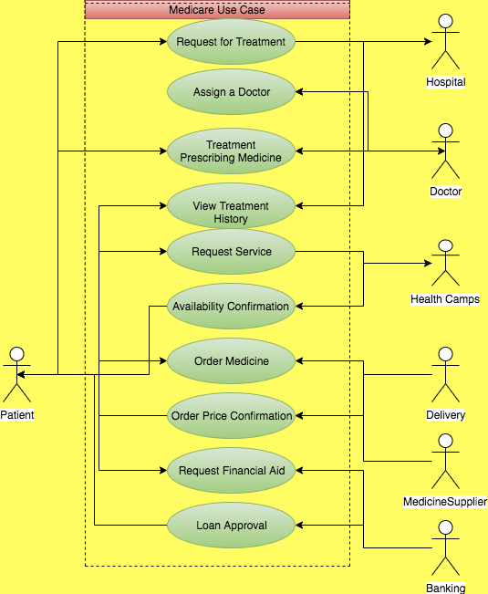

Slide 13
OBJECT MODEL

Slide 14
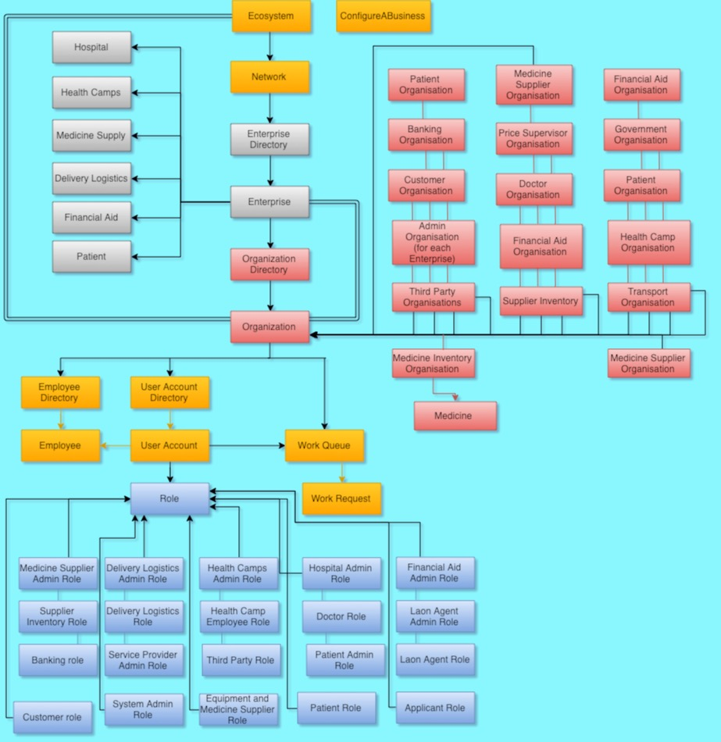
Notes:
Object model

Slide 15
WORKFLOW
Patient--Health-Camp
The patient raise request with the type of service provider coming for the health-camp and different kind of services they would be providing. Finally the patient will be able to check how much will that cost him/her and books for the health-camp check-up.
The request goes to one of the health-camp organization who process this request upon availability of the services and medicine.

Slide 16
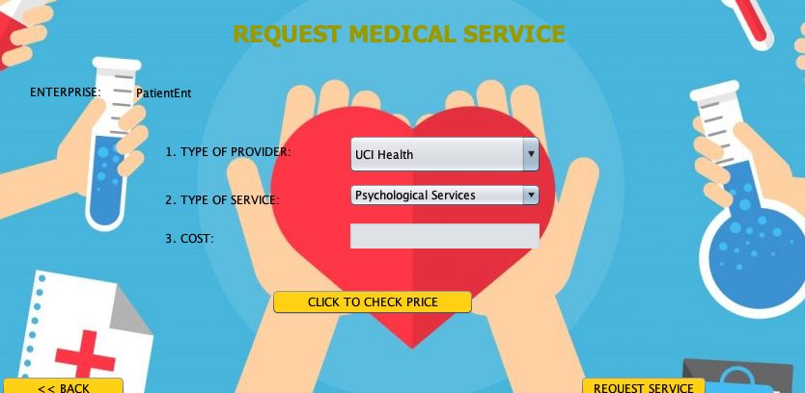
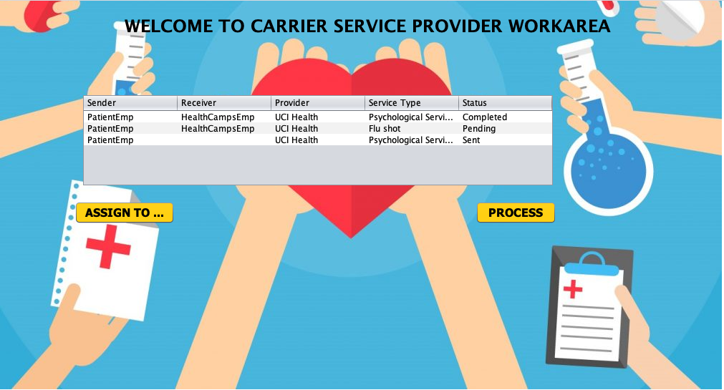
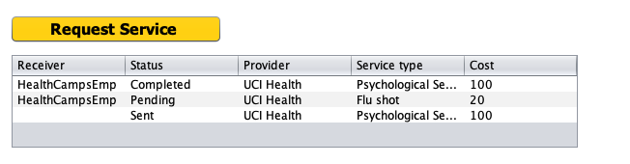

Slide 17
WORKFLOW
Patient-Hospital
The patient raises a request for the treatment with his personal details along with symptoms which is forwarded to doctor.
The doctor gets all the details of the patient by clicking on one of the request and then it assigns it to himself. The patient gets the update that his treatment and tests are under process.
The doctor completes the request by updating the different attributes like when is the next date he is available so that patient can visit, also updating the test result along with prescribing medicine.

Slide 18
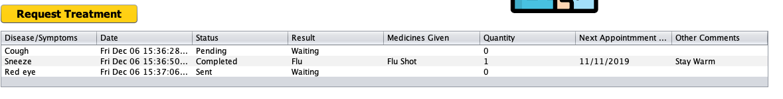
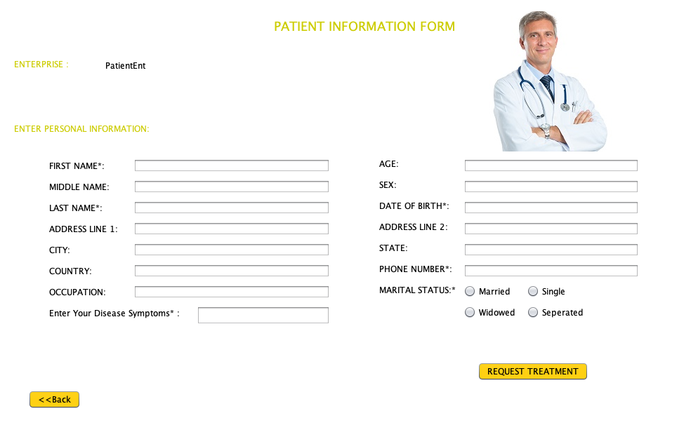

Slide 19
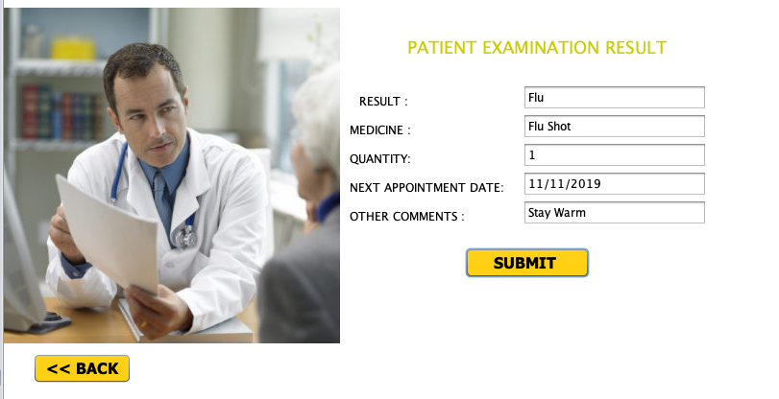
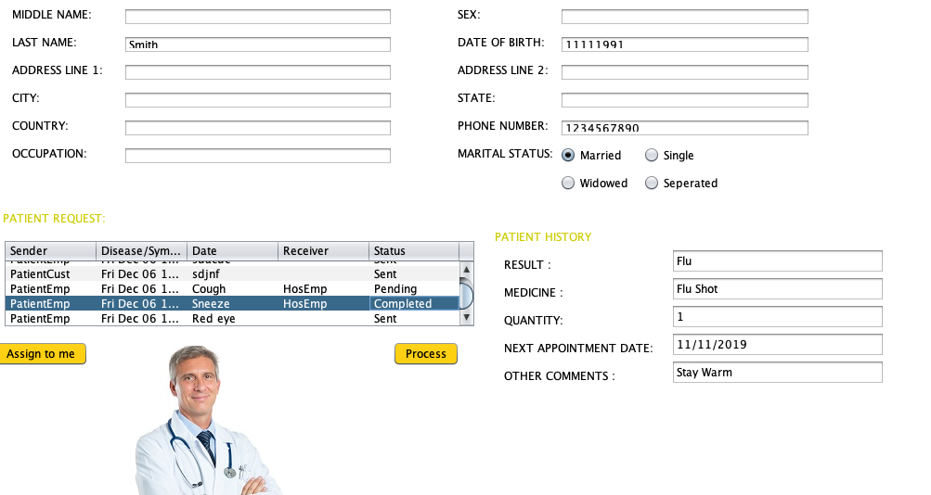

Slide 20
WORKFLOW
Patient-Financial Aid
Patient creates a request to get financial aid for medical checkups and medicine.
Patient enters all the personal details mentioning about the loan amount he/she needs.
Patient also need to upload the financial document as a proof of his/her income. The patient will get their loan rejected if they have taken the loan before.
The request will be processed by the funding employee from funding organization to process. The request will either be assigned to another person or will be processed by the employee.

Slide 21
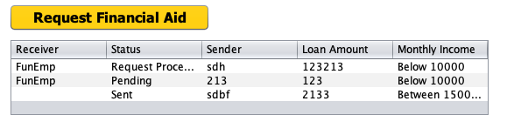
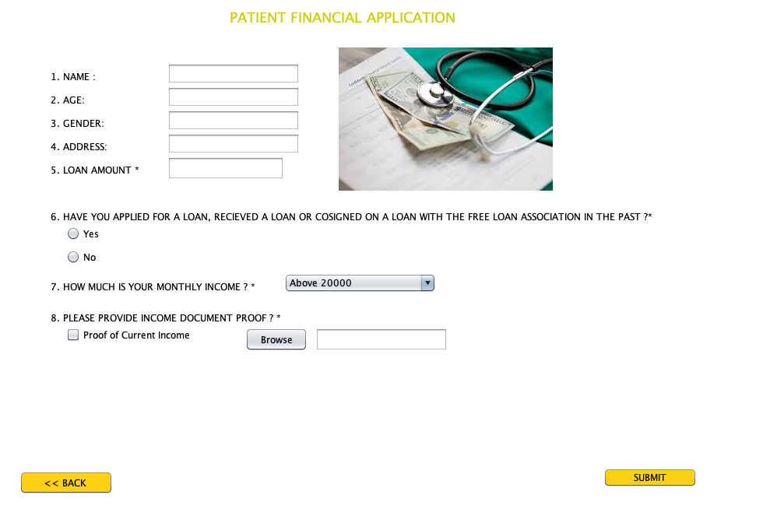

Slide 22
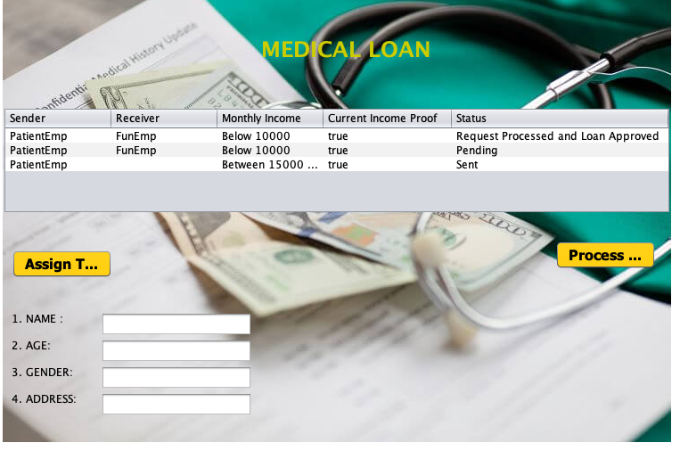

Slide 23
WORKFLOW
Patient-Medicine Transport
The patient creates a request mentioning the details of address and specifying the amount of medicine to be delivered.
The request then goes to the Delivery Logistics who estimates and assigns the cost of the transportation.
After the estimated price is assigned the process is assigned to Price approval supervisor for approval.
After it gets approved it is then forwarded to Medicine supply-store to assign the price of the medicine and also its availability then the status is updated to complete.

Slide 24
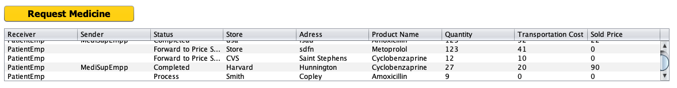
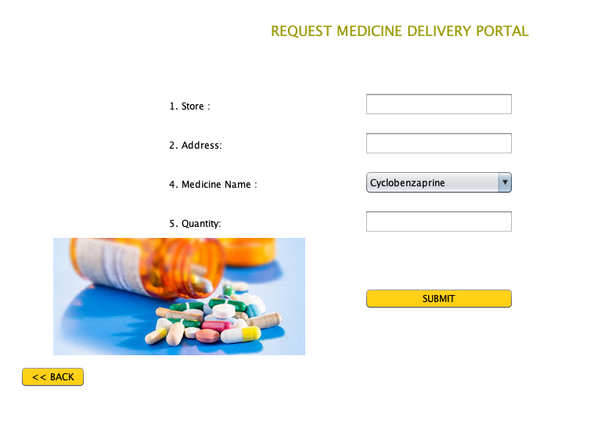
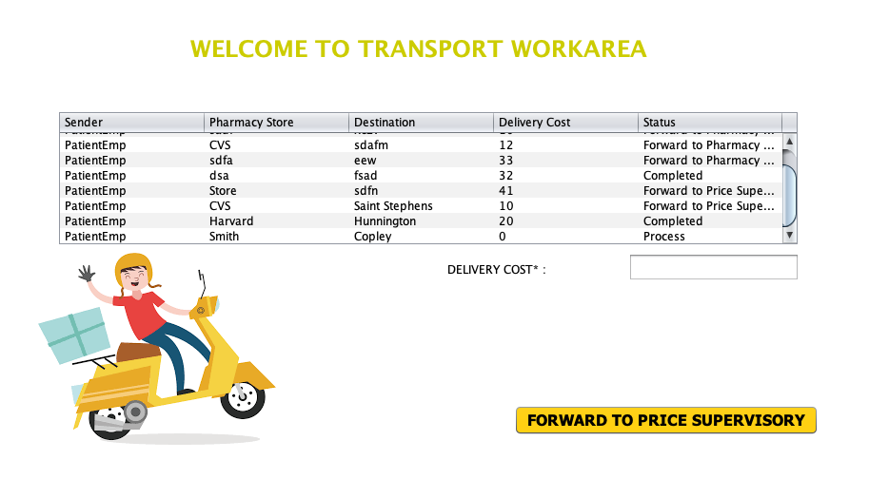

Slide 25
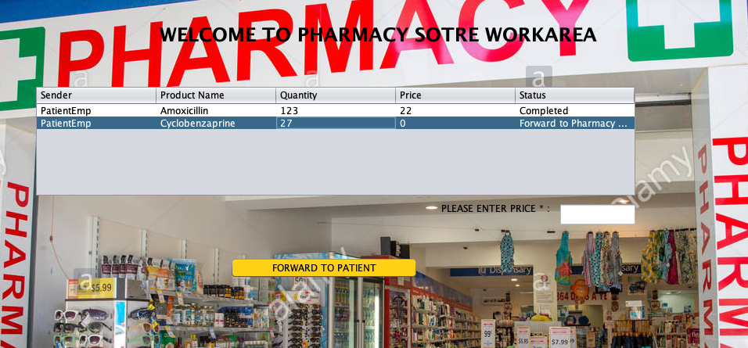

Slide 26
Thank You!

